Slide 1
Mobile Price Range Prediction
Presented By Vivek Rajput

Slide 2
Problem statement
In the competitive mobile phone market companies wantto understand sales data of mobile phones and factors which drive the prices.
The objective is to find out some relation between features of a mobile phone(eg:- RAM,Internal Memory, etc) and its selling price. In this problem, we do not have to predict theactual price but a price range indicating how high the price is.

Slide 3
Points to discuss
● Data description and summary
● Exploratory data analysis
● Heat map
● Machine learning algorithms
● conclusion

Slide 4
Data description
The data contains information regarding mobile phone features, specifications etc and their price range. The various features and information can be used to predict the price range of a mobile phone.
Battery_power - Total energy a battery can store in one time measured in mAh
Blue - Has bluetooth or not
Clock_speed - speed at which microprocessor executes instructions
Dual_sim - Has dual sim support or not
Fc - Front Camera mega pixels
Four_g - Has 4G or not
Int_memory - Internal Memory in Gigabytes
M_dep - Mobile Depth in cm
Mobile_wt - Weight of mobile phone

Slide 5
Data description(cont,.)
N_cores - Number of cores of processor
Pc - Primary Camera mega pixels
Px_height - Pixel Resolution Height
Px_width - Pixel Resolution Width
Ram - Random Access Memory in Mega Bytes
Sc_h - Screen Height of mobile in cm
Sc_w - Screen Width of mobile in cm
Talk_time - longest time that a single battery charge will last when you are
Three_g - Has 3G or not
Touch_screen - Has touch screen or not
Wifi - Has wifi or not
Price_range - This is the target variable with value of 0(low cost), 1(medium cost),
2(high cost) and 3(very high cost).

Slide 6
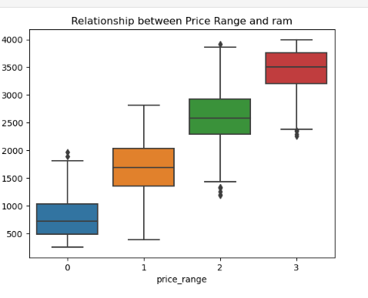

Slide 7
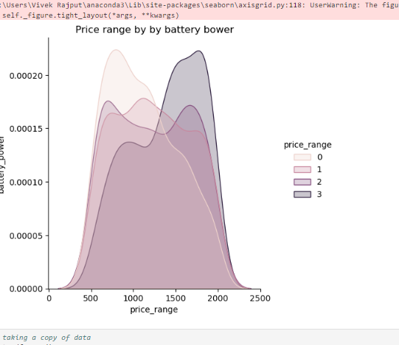

Slide 8
Heat Map
RAM and price_range shows high correlation which is a good sign, it signifies that RAM will play major deciding factor in estimating the price range.
There is some collinearity in feature pairs ('pc', 'fc') and ('px_width', 'px_height'). Both correlations are justified since there are good chances that if front camera of a phone is good, the back camera would also be good.
Also, if px_height increases, pixel width also increases, that means the overall pixels in the screen. We can replace these two features with one feature. Front Camera megapixels and Primary camera megapixels are different entities despite of showing colinearity. So we'll be keeping them as they are.

Slide 9
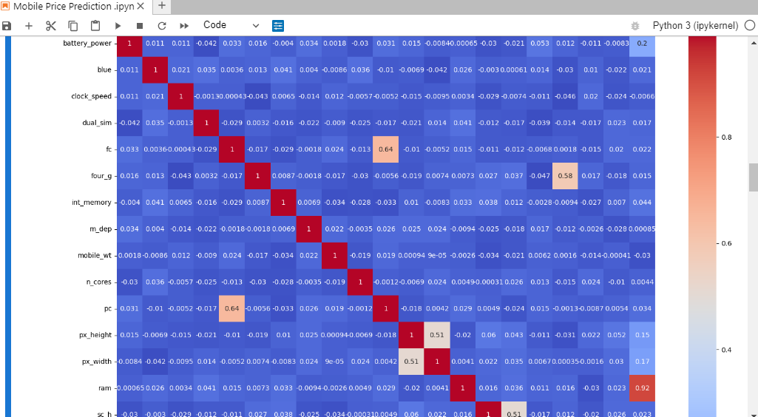

Slide 10
conclusion
From EDA we can see that here are mobile phones in 4 price ranges. The number of elements is almost similar.
half the devices have Bluetooth, and half don’t
there is a gradual increase in battery as the price range increases
Ram has continuous increase with price range while moving from Low cost to Very high cost
costly phones are lighter
RAM, battery power, pixels played more significant role in deciding the price range of mobile phone.
form all the above experiments we can conclude that logistic regression and, XGboosting with using hyperparameters we got the best results
The accuracy and performance of the model is evaluated by using confusion matrix

Slide 11
Thank You

